Slide 1
STUDENTS PERFORMANCE DATA ANALYSIS
Bootcamp Data Analyst with SQL & Python using Google Platform
Hawa Andini Hadi

Slide 2



INTRODUCTION
Purpose
Tools
Identify and analyze the key factors that affect students’ academic achievement.
Develop a basic Machine Learning model to forecast students’ final grades.
Present the analytical findings and predictions through an interactive dashboard.
Programming Language
Data Cleaning, Data Transformation, and Machine Learning (Simple Regression Model)
Data Visualization

Slide 3
DATA SET
Source: https://www.kaggle.com/datasets/haseebindata/student-performance-predictions/data
Student_ID | Name | Gender | Attendance_Rate | Study_Hours_Per_Week | Previous_Grade | Extracurricular_Activities | Parental_Support | Final_Grade | Study_Hours | Attendance_(%) | Online_Classes_Taken
1.0 | John | Male | 85.0 | 15.0 | 78.0 | 1.0 | High | 80.0 | 4.8 | 59.0 | FALSE
2.0 | Sarah | Female | 90.0 | 20.0 | 85.0 | 2.0 | Medium | 87.0 | 2.2 | 70.0 | TRUE
3.0 | Alex | Male | 78.0 | 10.0 | 65.0 | 0.0 | Low | 68.0 | 4.6 | 92.0 | FALSE
4.0 | Michael | Male | 92.0 | 25.0 | 90.0 | 3.0 | High | 92.0 | 2.9 | 96.0 | FALSE

Slide 4
DATA CLEANING, DATA TRANSFORMATION, AND MACHINE LEARNING (SIMPLE REGRESSION MODEL)

Slide 5
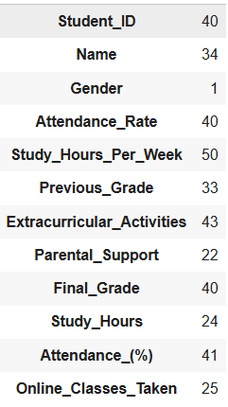
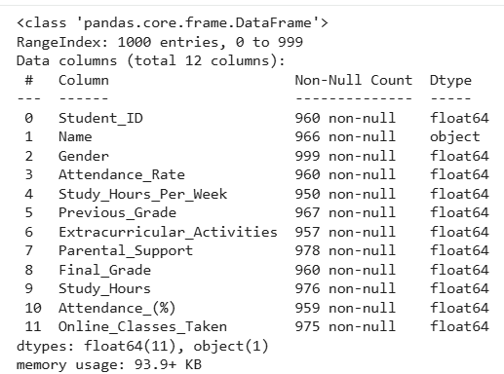
DATA HANDLING AND CLEANING
Missing values
Before importing the dataset into Google Colab, the dataset was first analyzed, and the columns containing text values were converted into numeric form, such as Gender, Parental Support, and Online Classes Taken.
After importing the dataset into Google Colab, the data was checked for missing values, data types of each column, and duplicate records using the Python programming language.

Slide 6
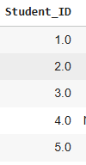
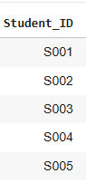
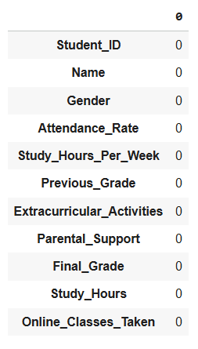
DATA HANDLING AND CLEANING
After
Missing values
If there are columns with missing values, they will be cleaned through several steps, such as:
Renaming the Student_ID column to sequential IDs (e.g., S001, S002, and so on) to ensure that each record has a unique identifier and to prevent missing values in the ID field.
Removing rows where both the Name and Gender columns are missing.
Filling missing names when Gender is available by assigning labels such as Unknown_Male and Unknown_Female.
Handling missing values using Mode and Median Imputation for columns such as Attendance_Rate,Study_Hours_Per_Week,Previous_Grade, Extracurricular_Activities, and Final_Grade.
Before

Slide 7
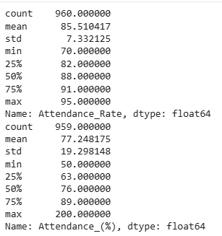
COLUMN REMOVAL
Before
After
Based on the descriptive analysis, it was found that the dataset contained two attributes representing student attendance levels: Attendance_Rate and Attendance_(%).
Upon further examination, the Attendance_(%) column was found to contain invalid values (e.g., 200%) and missing entries, while Attendance_Rate showed a stable and consistent distribution.
To maintain data consistency and avoid duplication, the Attendance_(%) column was removed from the dataset.

Slide 8
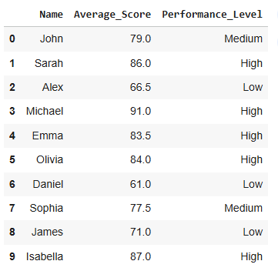
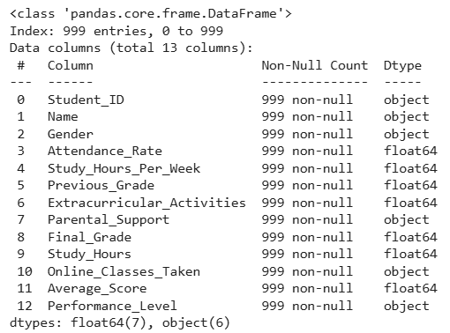
DATA TRANSFORMATION
Before visualizing the data in the dashboard, several new features were created to provide a more comprehensive overview of student performance. The Average_Score column was generated to represent each student’s overall academic achievement by calculating the average of their Previous_Grade and Final_Grade. Then, the Performance_Level column was introduced to classify students into three categories High, Medium, and Low based on their average scores. This transformation helps simplify the analysis of student achievement levels and supports more insightful visual representations in the dashboard.
In addition, the data types of several categorical variables Gender, Parental_Support, and Online_Classes_Taken were converted into the object data type to ensure proper handling and interpretation during the analysis and visualization processes.

Slide 9
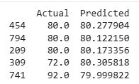
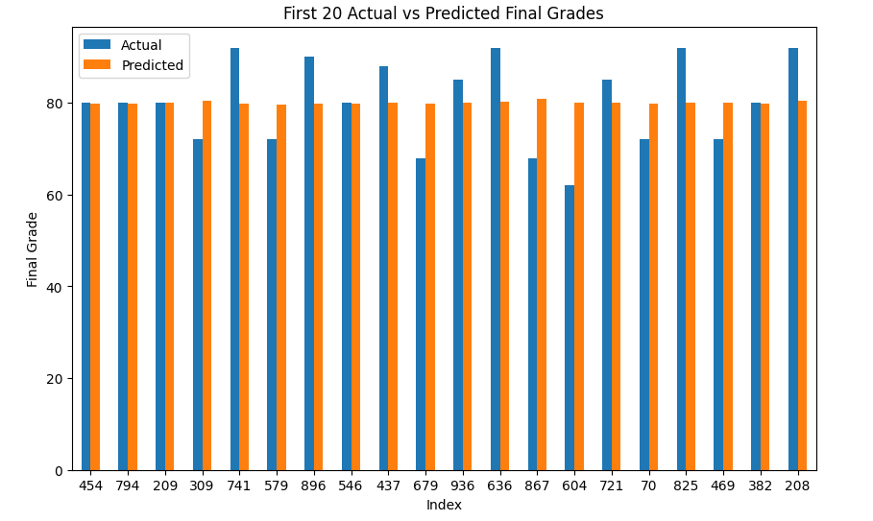
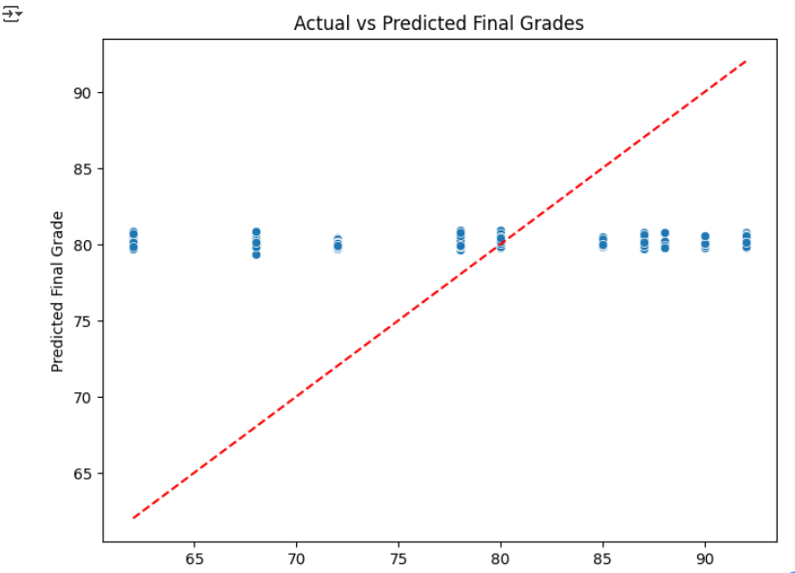
MACHINE LEARNING (SIMPLE REGRESSION MODEL)
The analysis results show that the regression model has fairly good accuracy. Most predicted values are close to the actual ones, as seen in the bar chart where the differences between them are minimal. Although there are slight deviations for some students, these differences are still reasonable, indicating that the model can estimate final grades quite accurately.
In addition, the scatter plot comparing actual and predicted values shows that most points lie close to the diagonal line, which represents perfect predictions. This indicates that the model successfully captures the data pattern and produces consistent results. Overall, the linear regression model is reliable enough to be used for visualizing the comparison between actual and predicted grades in the dashboard.

Slide 10
DATA VISUALIZATION AND ANALYSIS

Slide 11
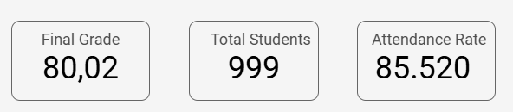
The three main indicators on the dashboard provide an overview of students’ overall performance. The average Final Grade of 80.02 indicates that, in general, students demonstrate good academic achievement. The total of 999 students recorded in the dataset shows that the analysis was conducted on a sufficiently large and representative population.
Meanwhile, the average Attendance Rate of 85.520 indicates that most students display strong discipline and consistency in attending learning activities. Overall, these three metrics illustrate that students maintain a stable level of academic performance.

Slide 12
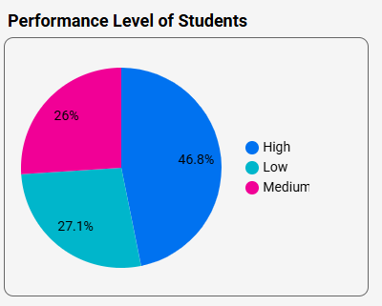
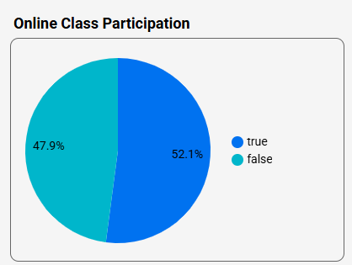
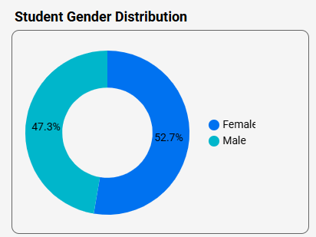
Student Demographics
Based on the Student Demographics dashboard, the students’ performance levels indicate that most students have a high academic performance of 46.8%, followed by 27.1% in the low category and 26% in the medium category. This shows that nearly half of the student population achieves excellent academic results, while the rest still need improvement, especially those in the low-performance group.
In terms of online class participation, 52.1% of students attended online classes, while 47.9% did not. This nearly balanced percentage indicates that learning activities are not limited to online classes but also include a significant portion of face-to-face learning. This may suggest that students have flexibility in the learning methods they use.
Meanwhile, the gender distribution of students shows a relatively balanced proportion between female (52.7%) and male (47.3%) students. This balance reflects equal gender representation in the academic environment. With this parity, there is no significant dominance of any gender group in terms of participation or academic achievement.

Slide 13
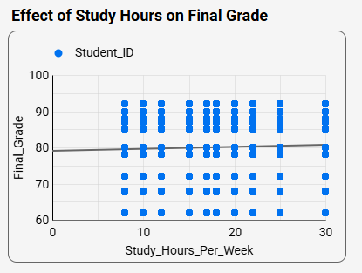
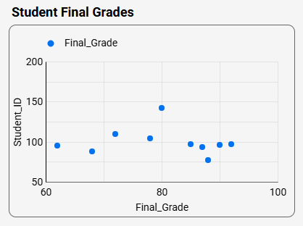
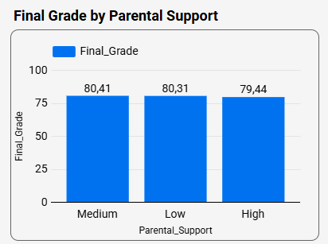
Academic Performance
Based on the Academic Performance dashboard, the relationship between Study Hours per Week and Final Grade shows a positive trend, although the effect is not very strong. Students who study more hours per week tend to have slightly higher final grades, but the increase is not significant. This indicates that study duration is not the only determining factor, as the quality and learning methods also play a crucial role in academic achievement.
In the Student Final Grades chart, the students’ scores show a wide variation. Most students achieve above-average grades, but there are still some who score lower. This suggests differences in students’ understanding levels and learning styles, highlighting the diversity in how each student absorbs and applies the material.
Meanwhile, the Final Grade by Parental Support chart reveals that the level of parental support does not create a significant difference in final grades. Interestingly, students with medium and low parental support have slightly higher average scores compared to those with high support. This implies that academic success may rely more on students’ intrinsic motivation and personal responsibility rather than solely on external parental involvement.

Slide 14
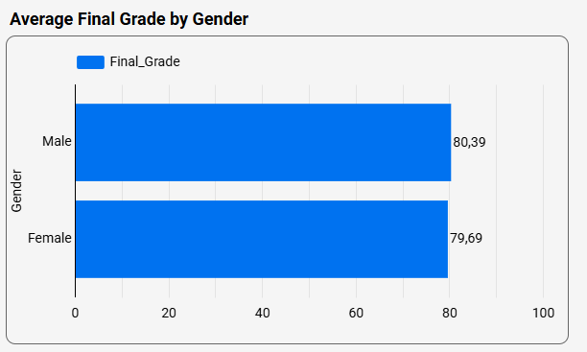
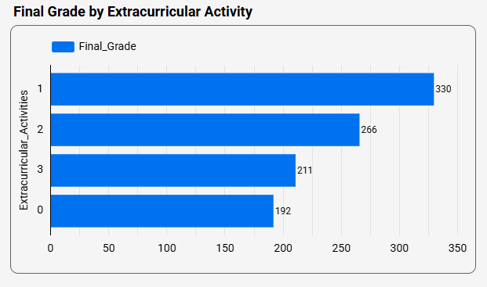
Detailed Analysis
From the Detailed Analysis dashboard, it can be seen that the average final grades between male and female students are quite similar. Male students have an average score of 80.39, which is slightly higher than female students at 79.69. This small difference indicates that gender has little impact on academic performance. In other words, both male and female students demonstrate relatively equal abilities in achieving academic success.
In addition, the Final Grade by Extracurricular Activity chart shows that students who participate in extracurricular activities tend to achieve higher final grades. Those involved in one or two activities perform better compared to those who do not participate at all. This suggests that engagement in extracurricular activities helps students develop responsibility, discipline, and a healthy balance between academic and non-academic pursuits.

Slide 15
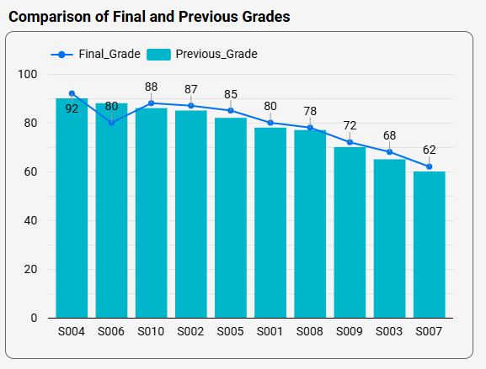
The Comparison of Final and Previous Grades chart shows differences in students' academic progress between their previous and final scores. Some students such as S004 showed a significant improvement from 80 to 92, indicating positive academic development. However, students like S003 and S007 experienced a noticeable decline in their grades. This pattern suggests that not all students achieved progress, as some faced setbacks that may have been influenced by decreased motivation, higher subject difficulty, or a lack of learning consistency.

Slide 16
CONCLUSION
From the analysis, it can be concluded that students generally show good academic performance, with an average final grade of 80.02 and an attendance rate of 85.520.
Some important findings are:
Gender has little influence on academic results, as male and female students perform almost equally.
Study hours per week have a positive but weak effect on grades, meaning that study quality is more important than study duration.
Extracurricular activities contribute positively to students’ performance by building discipline, motivation, and responsibility.
Parental support has minimal effect, suggesting that success depends more on personal effort and motivation.
The simple linear regression model predicts final grades quite accurately and helps identify learning patterns among students.

Slide 17
RECOMMENDATIONS
To improve student performance and support further analysis, it is recommended to:
Encourage a healthy balance between studying and extracurricular participation.
Focus on enhancing learning quality through effective and engaging teaching strategies.
Strengthen students’ internal motivation to help them stay consistent and self-driven.
Regularly monitor student data to detect performance issues early.
Continue developing the prediction model by adding more variables to improve accuracy.

Slide 18
https://lookerstudio.google.com/reporting/bb61251f-e034-4d6a-8838-38ac83929f84

